Slide 1
1 meter of elevation head
1 meter
Reference elevation
1 meter of pressure head
1 meter of velocity head

Slide 2
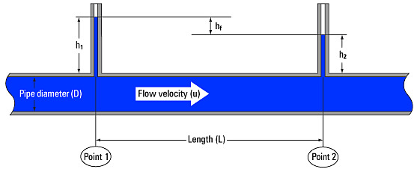
V_{in}
V_{out}
A_{in}
x
A_{out}
in
out

Slide 3

Horizontal orifice
Vertical orifice
$$Δh$$

